Slide 1





Verifiable by Design: Aligning Language Models to Quote from Pre-Training Data
Jingyu (Jack) Zhang
Marc Marone
Tianjian Li
Benjamin Van Durme*
Daniel Khashabi*
*Equal Advising

Slide 2
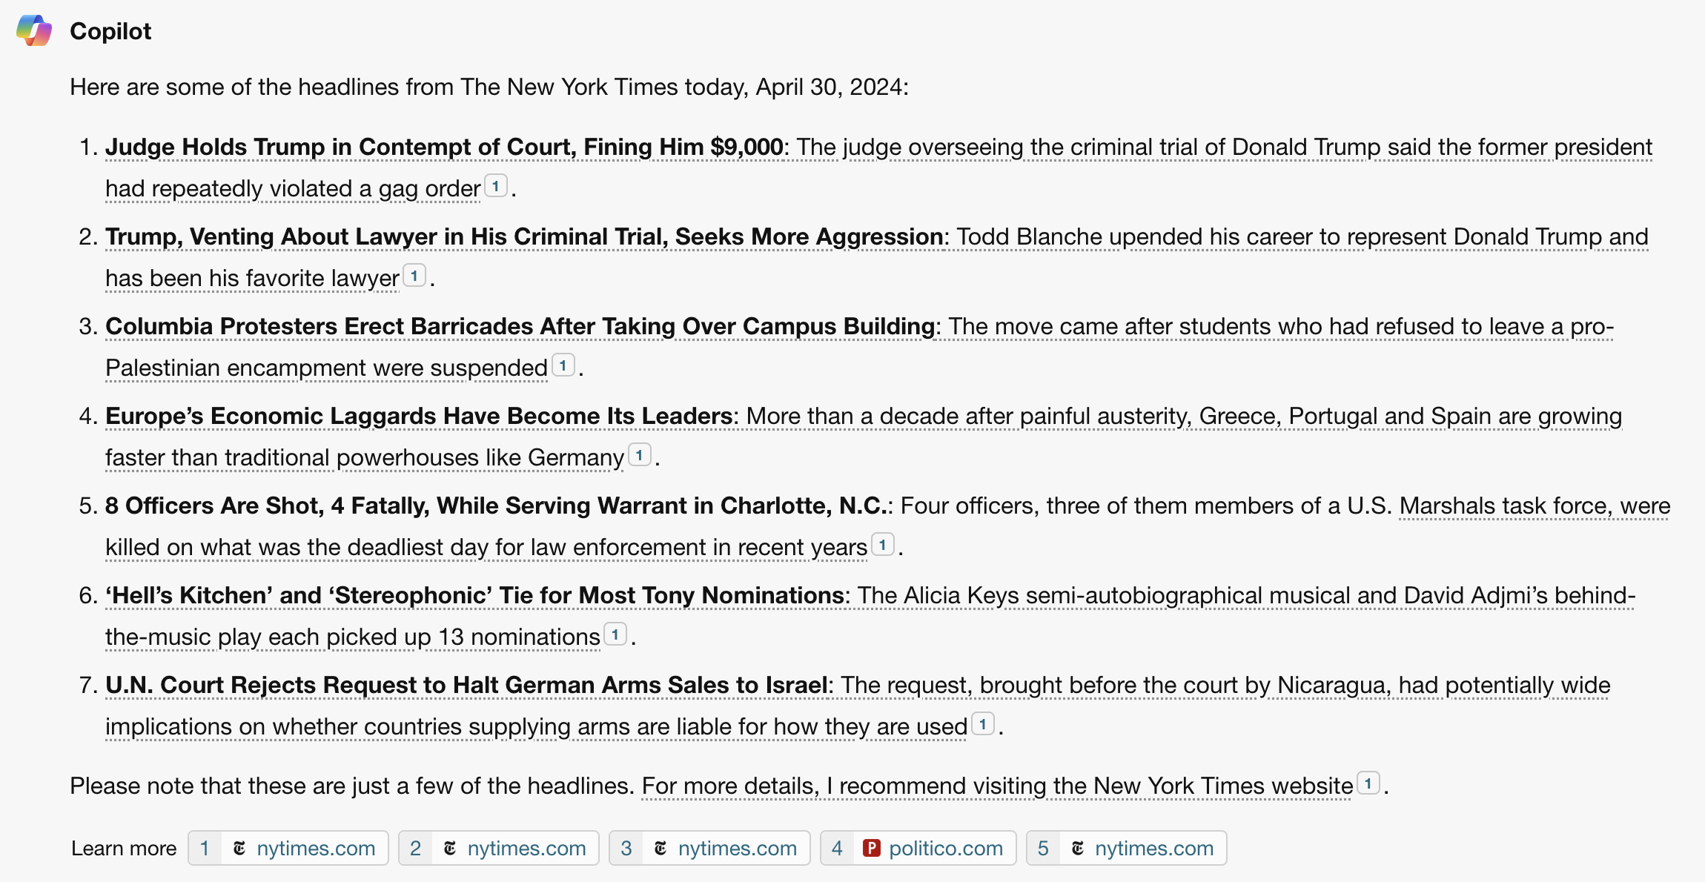
LLMs are powerful
, but not always reliable
Known to produce seemingly plausible but erroneous outputs, aka hallucination
🧐
User: is this hallucination???
Notes:
- start with hallucination
- so user will need to verify the response against trusted responses
- how can user verify? (1) by themselves (2) citation
– we propose the quoting interface
- Emphasize the quoting is from **pre-training**
- give a high-level overview of method before diving in details

Slide 3
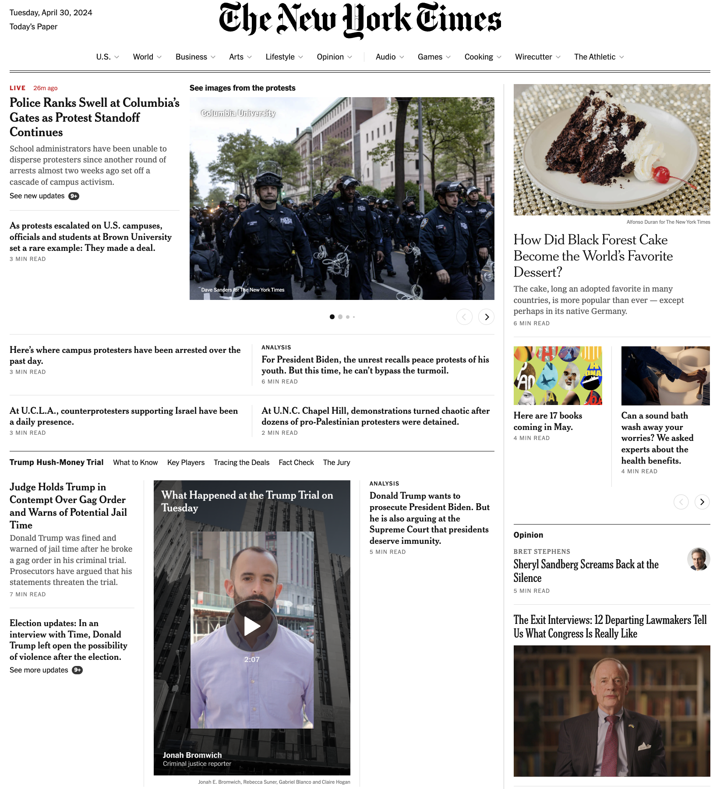
Verifiability is challenging
To trust LLMs, users need to verify generated claims against trusted resources
However, non-trivial to fact-check lengthy free-form generation!
🧐
User: which NYT article support this claim???
Notes:
- start with hallucination
- so user will need to verify the response against trusted responses
- how can user verify? (1) by themselves (2) citation
– we propose the quoting interface
- Emphasize the quoting is from **pre-training**
- give a high-level overview of method before diving in details

Slide 4
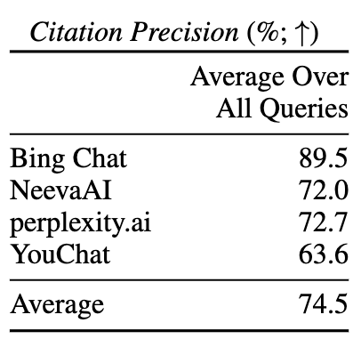
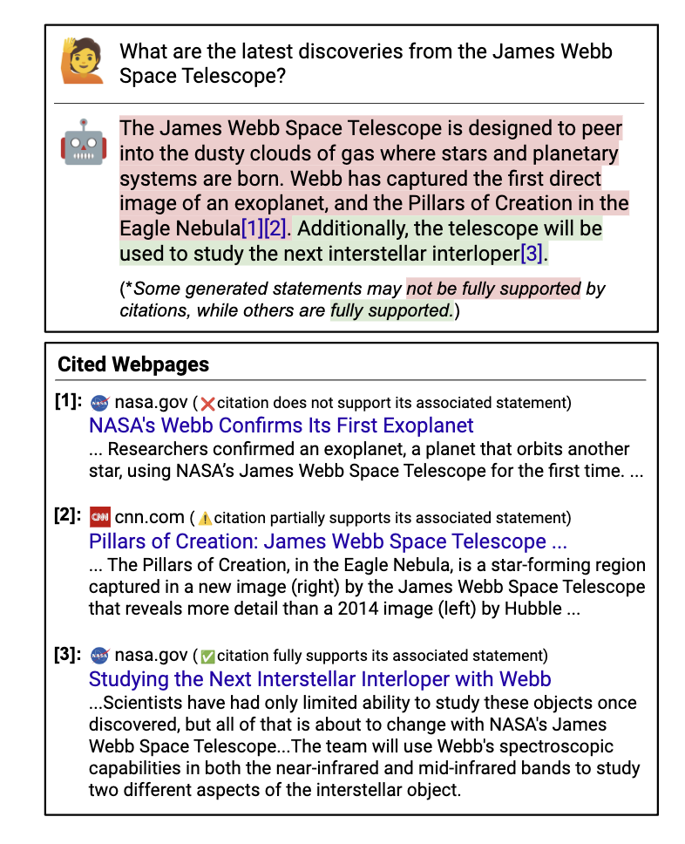
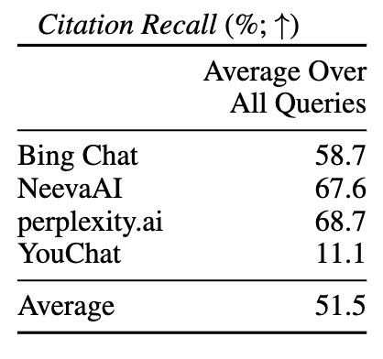
Existing methods for verifiability
Search/retrieval + citation helps, but is not guaranteed to be accurate
Non-trivial to verify whether text is supported by citation
Nelson Liu, Tianyi Zhang, and Percy Liang. 2023. Evaluating Verifiability in Generative Search Engines. In Findings of the Association for Computational Linguistics: EMNLP 2023

Slide 5



Verifiability by Quoting
We propose increasing verifiability by generating verbatim quotes from high-quality sources of pre-training data, such as Wikipedia.
Quote-Tuning: aligning LLMs to quote from their pre-training data!
Make the model prefer generation with more quotes over less quotes!
Align for quoting using preference optimization algorithms such as DPO
Base LLM
LLM that can quote
align for quoting
generate
Response with quotes: Jeopardy! was created by Merv Griffin and first aired in 1964, while Wheel of Fortune was also created by Merv Griffin and first aired in 1975. Therefore, Jeopardy! is older than Wheel of Fortune.
“ ”
verify quotes
High-quality subset of pre-training corpus

Slide 6

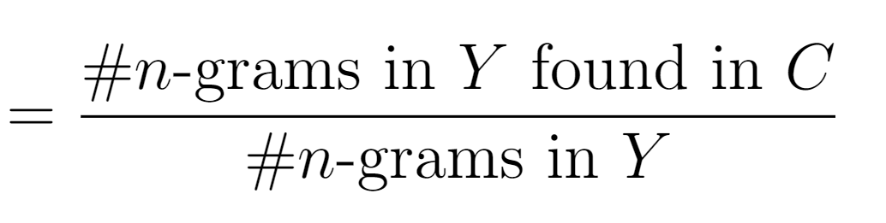
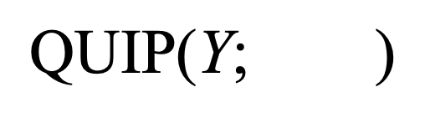
Background: measuring quoting at scale
generated text
A large corpus
$$\text{QUIP}\text{(}\text{Y}\text{; } \text{)}$$
Calculate quoting precision with QUIP-Score (Weller et al., 2024)
QUIP-Score is backed by efficient membership testing with Data Portraits (Marone and Van Durme, 2023)

Slide 7
Our method: Quote-Tuning
Pre-trained LLM
Quote-tuned LLM
Prompt Dataset
Step 3: Preference Optimization
Prompt: Which is older jeopardy or wheel of fortune?
High-quality subset of pre-training corpus
“ ”
Preference Dataset for Quoting
Step 1: Sample
multiple responses
Prompt: Which is older jeopardy or wheel of fortune?
Chosen Response: Jeopardy! was created by Merv Griffin and first aired in 1964, while Wheel of Fortune was also created by Merv Griffin and first aired in 1975. Therefore, Jeopardy! is older than Wheel of Fortune.
Rejected Response: Jeopardy! was created in 1964 by Merv Griffin, while Wheel of Fortune was created in 1975 by Merv Griffin and Roy Leonard. Therefore, Jeopardy! is older than Wheel of Fortune.
Measure quoting via efficient membership testing
Raw LLM Responses
Response: Jeopardy! was created by Merv Griffin and first aired in 1964, while Wheel of Fortune was also created by Merv Griffin and first aired in 1975. Therefore, Jeopardy! is older than Wheel of Fortune.
🥇🥈🥉
✅ QUIP: 31.4, length: 66
Step 2: Constructing preference data via rank-by-quoting
≈
❌ QUIP: 1.99, length: 60

Slide 8
Step 1: Sample candidate responses
Prompt Dataset
Prompt: Which is older jeopardy or wheel of fortune?
High-quality subset of pre-training corpus
Step 1: Sample
multiple responses
Raw LLM Responses
Response: Jeopardy! was created by Merv Griffin and first aired in 1964, while Wheel of Fortune was also created by Merv Griffin and first aired in 1975. Therefore, Jeopardy! is older than Wheel of Fortune.
Step 1. Generate completions from an LLM (e.g. using QA pairs or text completions)

Slide 9
Step 2: Synthesize Dataset by Filtering
Prompt Dataset
High-quality subset of pre-training corpus
Prompt: Which is older jeopardy or wheel of fortune?
Preference Dataset for Quoting
Step 1: Sample
multiple responses
Prompt: Which is older jeopardy or wheel of fortune?
Chosen Response: Jeopardy! was created by Merv Griffin and first aired in 1964, while Wheel of Fortune was also created by Merv Griffin and first aired in 1975. Therefore, Jeopardy! is older than Wheel of Fortune.
Rejected Response: Jeopardy! was created in 1964 by Merv Griffin, while Wheel of Fortune was created in 1975 by Merv Griffin and Roy Leonard. Therefore, Jeopardy! is older than Wheel of Fortune.
Measure quoting via efficient membership testing
Raw LLM Responses
Response: Jeopardy! was created by Merv Griffin and first aired in 1964, while Wheel of Fortune was also created by Merv Griffin and first aired in 1975. Therefore, Jeopardy! is older than Wheel of Fortune.
🥇🥈🥉
✅ QUIP: 31.4, length: 66
Step 2: Constructing preference data via rank-by-quoting
≈
❌ QUIP: 1.99, length: 60
Step 2. We can construct a preference dataset by ranking generations by the amount of quoting
(QUIP-Score; Weller et al., EACL 2024)

Slide 10
Step 3: Making the model prefer more quoting!
Pre-trained LLM
Quote-tuned LLM
Prompt Dataset
Step 3: Preference Optimization
Prompt: Which is older jeopardy or wheel of fortune?
High-quality subset of pre-training corpus
“ ”
Preference Dataset for Quoting
Step 1: Sample
multiple responses
Prompt: Which is older jeopardy or wheel of fortune?
Chosen Response: Jeopardy! was created by Merv Griffin and first aired in 1964, while Wheel of Fortune was also created by Merv Griffin and first aired in 1975. Therefore, Jeopardy! is older than Wheel of Fortune.
Rejected Response: Jeopardy! was created in 1964 by Merv Griffin, while Wheel of Fortune was created in 1975 by Merv Griffin and Roy Leonard. Therefore, Jeopardy! is older than Wheel of Fortune.
Measure quoting via efficient membership testing
Raw LLM Responses
Response: Jeopardy! was created by Merv Griffin and first aired in 1964, while Wheel of Fortune was also created by Merv Griffin and first aired in 1975. Therefore, Jeopardy! is older than Wheel of Fortune.
🥇🥈🥉
✅ QUIP: 31.4, length: 66
Step 2: Constructing preference data via rank-by-quoting
≈
❌ QUIP: 1.99, length: 60
Step 3. Tune a model to prefer more quotes with direct preference optimization (DPO)!

Slide 11
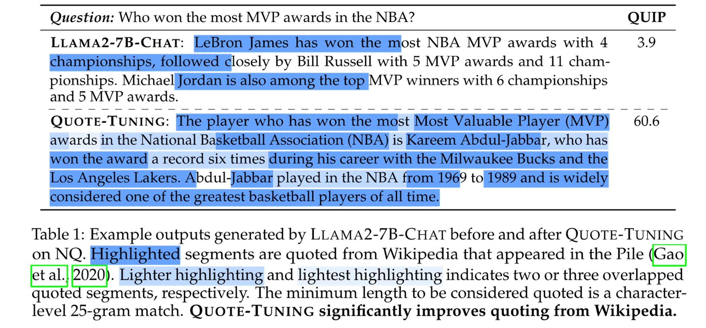
Quote-Tuning significantly increases amount of quoting
sparse quotes
generation is densely quoted!

Slide 12
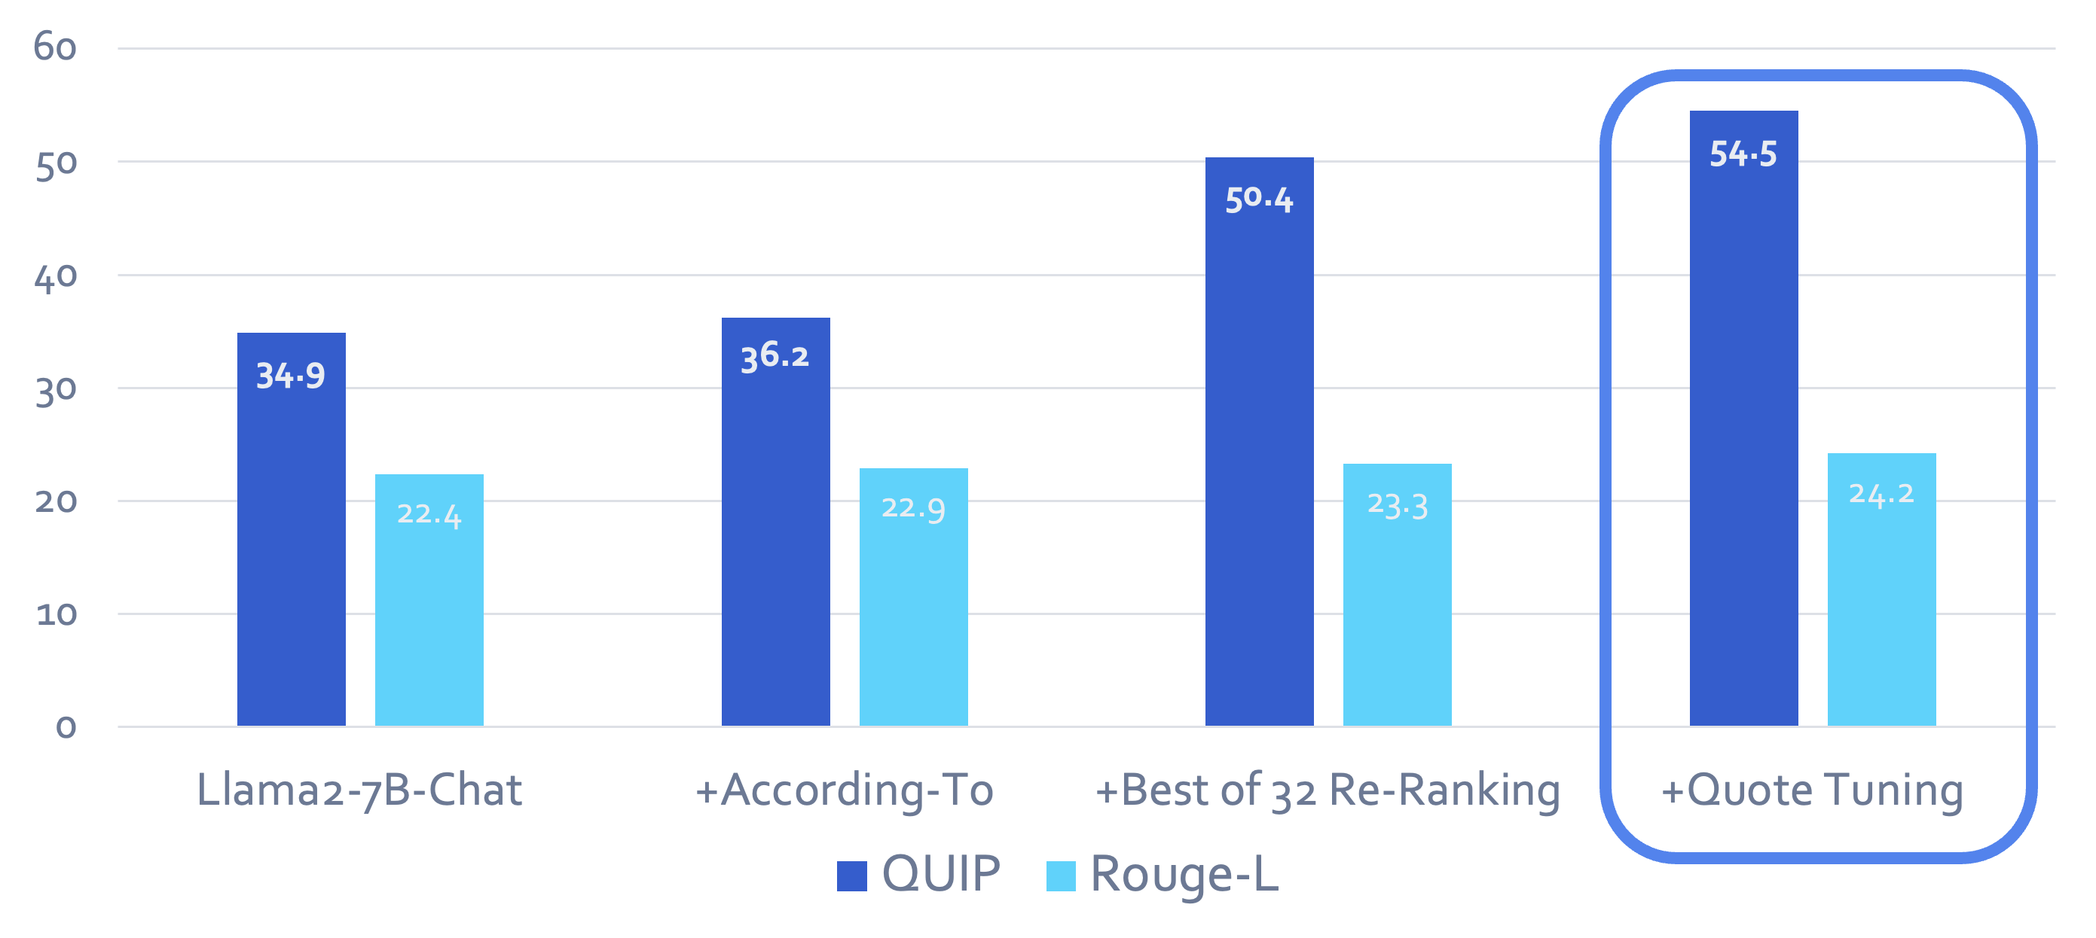
Same Quality, More Quoting!
You can obtain models that provide more quoted responses,
without losing accuracy.

Slide 13
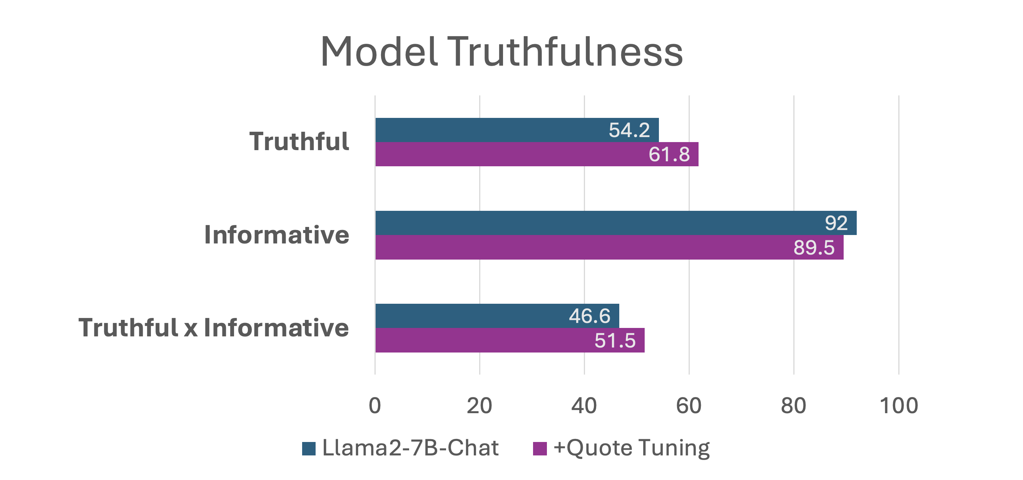
Quote-Tuning improves truthfulness
Dataset: TruthfulQA (Lin et al., 2021)

Slide 14
Summary and Future Directions
LLMs can be aligned to quote from known sources observed in their pre-training data
Quoting makes the verifiability question trivial
Open questions and future directions:
How do we incentivize quoting when it matters?
How to ensure long, contiguous quotes?
How to generalize to reasoning problems, and more general settings?
…

Slide 15
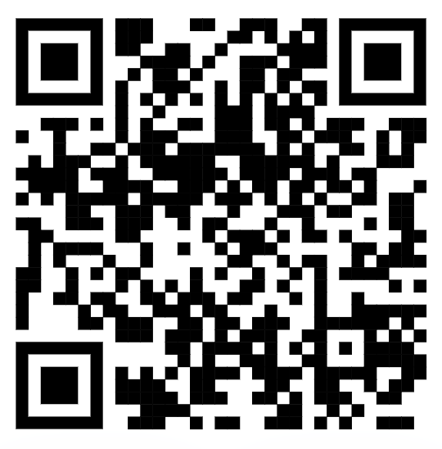
Questions?
<-link to preprint
Thank you!

